Slide 1
Chapter 11 Classes Continued
Fundamentals of Java: AP Computer Science Essentials, 4th Edition
Lambert / Osborne

Slide 2
Objectives
Explain when it is appropriate to include class (static) variables and methods in a class.
Describe the role of Java interfaces in a software system and define an interface for a set of implementing classes.
Explain how to extend a class through inheritance.
‹#›
‹#›

Slide 3
Objectives (continued)
Discuss the use of polymorphism and explain how to override methods in a superclass.
Place the common features (variables and methods) of a set of classes in an abstract class.
Explain the implications of reference types for equality, copying, and mixed-mode operations.
Define and use methods that have preconditions, postconditions, and that throw exceptions.
‹#›
‹#›

Slide 4
Vocabulary
abstract class
abstract method
aggregation
aliasing
class (static) method
class (static) variable
concrete class
dependency
final method
inheritance
interface
overriding
postcondition
precondition
‹#›
‹#›

Slide 5
Introduction
The real power of object-oriented programming is the capacity to reduce code and distribute responsibilities for such things are error handling in a software system.
Static variables and methods: when information that needs to be stared among all instances of a class it is represented by static variables and accessed by static methods.
‹#›
‹#›

Slide 6
Introduction (continued)
Interfaces: way of requiring a class to implement a set of methods and a way of informing clients about services. The glue that holds together cooperating classes.
Inheritance: mechanism for reusing code by extending characteristics through a hierarchy.
Abstract class: uninstantiated class used to define common features and behavior of a subclass.
‹#›
‹#›

Slide 7
Introduction (continued)
Polymorphism: when similar methods in different classes use the same name.
Preconditions: specify the use of methods.
Postconditions: results if preconditions are met.
Exceptions: halt the program at an error.
Reference types: issues when comparing and copying objects (identity of an object; there can be multiple references to the same object).
‹#›
‹#›

Slide 8
Class (static) Variables and Methods
An instance variable belongs to an object and is an allocated storage when the object is created.
Each object has its own set of instance variables.
A instance method is activated when a message is sent to the object.
Class variables belong to a class.
Storage is allocated at program startup and is independent of number of instances created.
‹#›
‹#›

Slide 9
Class (static) Variables and Methods (continued)
Class method: activated when a message is sent to the class rather than the object.
The static modifier designates class variables and methods.
Counting the Number of Students Instantiated:
Example: count student objects instantiated during execution of an application.
‹#›
‹#›

Slide 10
Class (static) Variables and Methods (continued)
Counting the Number of Students Instantiated (cont):
Introduce studentCount variable.
Incremented each time a student object is instantiated.
Because it is independent of any particular student object, it must be a class variable.
Method to access studentCount variable.
getStudentCount returns variable’s value on demand.
Does not manipulate any particular student object, so must be a class method.
‹#›
‹#›

Slide 11
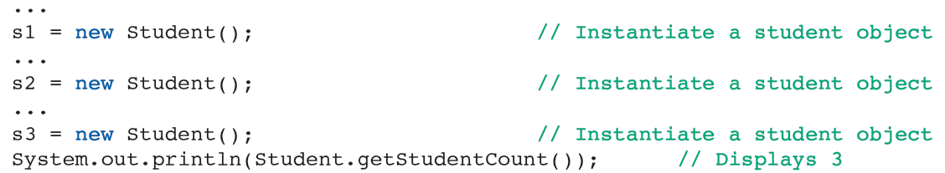
Class (static) Variables and Methods (continued)
Modifying the Student Class:
Add the class variable and method to class template.
‹#›
‹#›

Slide 12
Class (static) Variables and Methods (continued)
Class Constants:
Class constant value is assigned when a variable is declared and cannot be changed.
Names are usually capitalized.
Example: max in class Math returns the maximum of two parameters and min returns the minimum.
Public because clients might like to access them.
‹#›
‹#›

Slide 13
Class (static) Variables and Methods (continued)
Rules for Using static Variables:
Class method can reference only static variables (not instance).
Instance methods can reference static and instance variables.
The Math Class Revisited:
All of the methods and variables in the example Math class are static.
‹#›
‹#›

Slide 14
Turtle Graphics
TurtleGraphics: nonstandard open-source Java package.
Turtle Graphics Messages:
The pen is an instance of the class StandardPen.
Drawing is done in a window by sending messages to the pen.
‹#›
‹#›

Slide 15
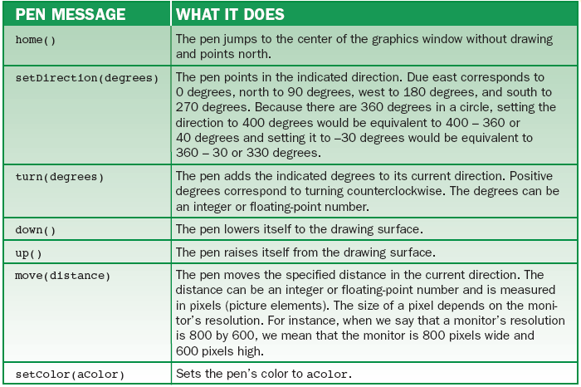
Turtle Graphics (continued)
Turtle Graphics Messages (cont):
Pen messages
‹#›
‹#›

Slide 16
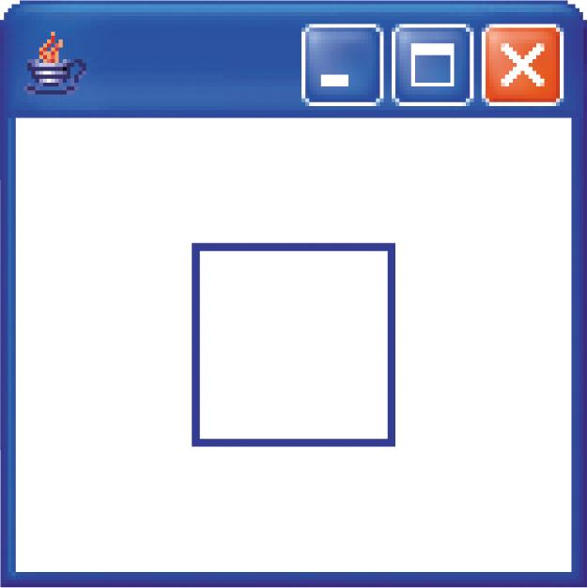
Turtle Graphics (continued)
Turtle Graphics Messages (cont):
Initially, a pen is:
In the center of a graphics window (position [0,0]).
In the down position, pointing north.
A square drawn at the center of a graphics window
‹#›
‹#›

Slide 17
Java Interfaces—The Client Perspective
Two definitions of interface:
Part of software that interacts with human users.
A list of a class’s public methods.
When related classes have the same interface, they can be used interchangeably.
Example: StandardPen is one of five classes that conform to the same interface.
WigglePen and RainbowPen.
‹#›
‹#›

Slide 18
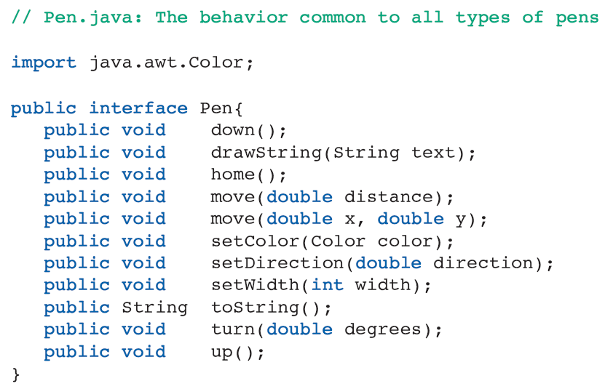
Java Interfaces—The Client Perspective (continued)
The Pen interface:
‹#›
‹#›

Slide 19
Java Interfaces—The Client Perspective (continued)
Drawing with Different Types of Pens:
Three variables (p1, p2, p3) given the type Pen.
Variables are associated with specialized pen objects.
Each object responds to the same messages with slightly different behaviors.
‹#›
‹#›

Slide 20
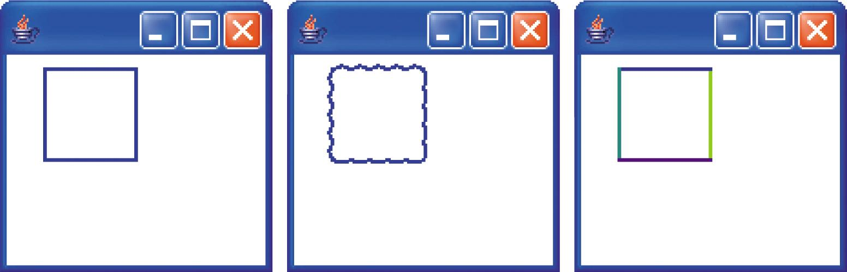
Java Interfaces—The Client Perspective (continued)
Drawing with Different Types of Pens (cont):
A square drawn with three types of pens
‹#›
‹#›

Slide 21
Java Interfaces—The Client Perspective (continued)
Static Helper Methods:
Factor common pattern of code into a method where it’s written just once.
Example: drawSquare.
Using Interface Names:
Methods that use interface types are general.
It is easier to maintain a program that uses interface types.
‹#›
‹#›

Slide 22
Java Interfaces—The Implementation Perspective
Suppose we need to perform basic manipulations on circles and rectangles.
Positioning, moving, and stretching.
Want shapes to implement methods that compute area, draw themselves with a pen, and return descriptions of themselves.
‹#›
‹#›

Slide 23
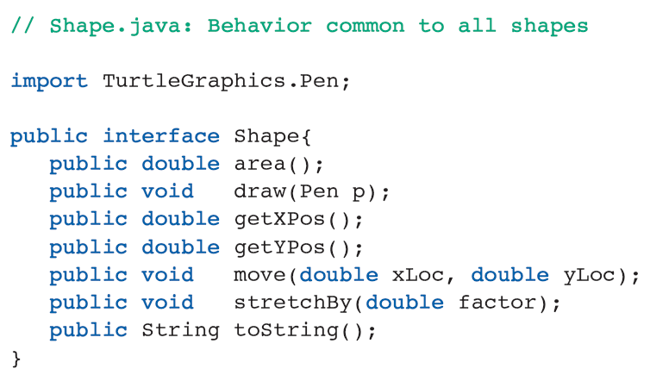
Java Interfaces—The Implementation Perspective (continued)
Behavior described in an interface called Shape:
‹#›

Slide 24
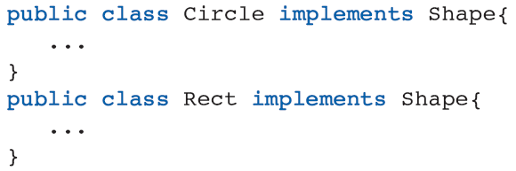
Java Interfaces—The Implementation Perspective (continued)
Classes Circle and Rect:
The phrase implements Shape implies that:
Both classes implement all the methods in the Shape interface.
A variable declared as a Shape can be associated with an object of either class.
‹#›
‹#›

Slide 25
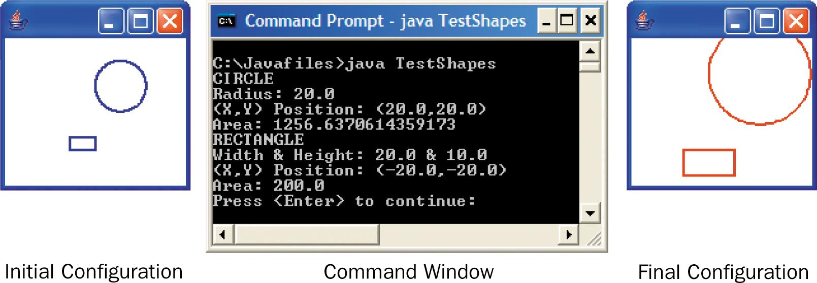
Java Interfaces—The Implementation Perspective (continued)
Testing the Classes:
Output from the TestShapes program
‹#›
‹#›

Slide 26
Java Interfaces—The Implementation Perspective (continued)
Final Observations:
An interface contains methods (not variables).
Methods in an interface are usually public.
Polymorphic methods: when more than one class implements an interface.
A class can implement more than one interface, and methods in addition to those in the interface.
Interfaces can be organized in an inheritance hierarchy.
‹#›
‹#›

Slide 27
Code Reuse Through Inheritance
All Java classes are part of an immense hierarchy, with Object at the room.
A class can add new variables to inherited characteristics as needed.
Classes can also add new methods and/or modify inherited methods.

Slide 28
Code Reuse Through Inheritance (continued)
Review of Terminology:
Root: top position in upside-down tree hierarchy (Object).
Subclasses: extend Object (AAA).
Superclass: the class immediately above another (AAA to BBB and CCC).

Slide 29
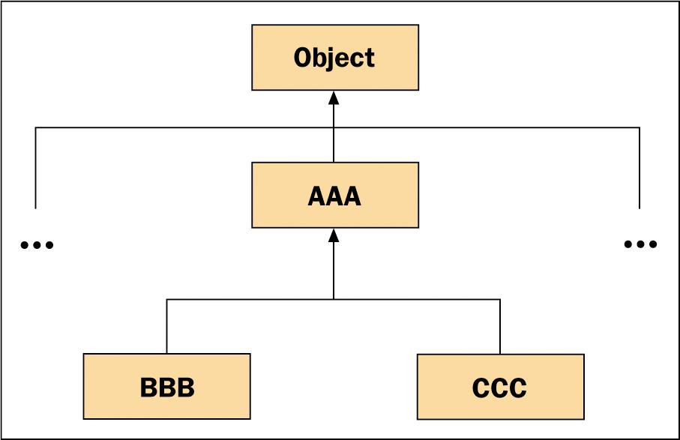
Code Reuse Through Inheritance (continued)
Review of Terminology (cont):
Part of a class hierarchy

Slide 30
Code Reuse Through Inheritance (continued)
Wheel as a Subclass of Circle:
Wheel extends Circle, so it inherits properties from Circle, such as implements Shape.
The variable spokes is the only one declared; all others are inherited from Circle.
Circle variables must be declared protected.
Circle’s descendents can access the variables while hiding them from other classes.

Slide 31
Code Reuse Through Inheritance (continued)
Detailed Explanation:
A protected method is accessible to a class’s descendents, but not any other classes in the hierarchy.
The keyword super activates a constructor in Circle, and the parameter list used with super determines which constructor in Circle is called.

Slide 32
Code Reuse Through Inheritance (continued)
Detailed Explanation (cont):
The keyword super can be used in methods other than constructors:
Can appear in any place with the method.
Activates the named method in the superclass (polymorphic).

Slide 33
Code Reuse Through Inheritance (continued)
Detailed Explanation (cont):
Methods that are inherited unchanged from Circle are not implemented in Wheel.
Methods redefined in class Wheel when the wheel object responds differently to a message than a circle object.
Subclasses can have methods not in the superclass.
You cannot cast a variable to a type that conflicts with its identity.

Slide 34
Working with Arrays of Objects
The element type of an array can be primitive, reference (abstract or concrete), or an interface.
Primitive and concrete: all array elements are the same type and respond to the same type of operators or methods.
Interfaces, abstract, or superclasses: arrays can contain objects of different types.

Slide 35
Working with Arrays of Objects (continued)
Polymorphism, Casting, and instanceOf:
Polymorphism can be used to send messages to elements that are of different concrete classes if they are implement Shape, for example.
Use parentheses to determine casting order.
instanceOf variable: used to determine if an object’s type before casting an object to it.

Slide 36
Working with Arrays of Objects (continued)
Arrays of Object:
Can insert any Object into an array of object, and replace any array of Object with another array of any reference type.
Be careful when an object is accessed in an Object array: casting often must occur because Object includes so few methods the array element supports.

Slide 37
Inheritance and Abstract Classes
Inheritance reduces code duplication.
Abstract class: cannot be instantiated.
Concrete class: extends a class and are instantiated.
Abstract methods: methods in an abstract class for which you cannot write any code.
Final method: cannot be overridden by a subclass.

Slide 38
Some Observations About Interfaces, Inheritance, and Relationships Among Classes
A Java interface has a name and consists of method headers.
One or more classes can implement the same interface.
If a variable is declared to be interface, it cannot be associated with an object from any class that implements the interface.
If a class implements an interface, so do its subclasses.

Slide 39
Some Observations About Interfaces, Inheritance, and Relationships Among Classes (continued)
A subclass inherits the characteristics of its superclass.
A subclass can add new variables and methods or modify inherited methods.
Characteristics common to several classes can be collected in common abstract superclass that is never instantiated.
Abstract class can contain headers for abstract methods implemented in subclasses.

Slide 40
Some Observations About Interfaces, Inheritance, and Relationships Among Classes (continued)
Finding the Right Method:
When a message is sent to an object, Java looks for a matching method.
Starts in object’s class, continues up hierarchy.
Implementation, Extension, Overriding, and Finality:
Each subclass is forced to implement the abstract methods in its superclass.

Slide 41
Some Observations About Interfaces, Inheritance, and Relationships Among Classes (continued)
Implementation, Extension, Overriding, and Finality (cont):
There are two kinds of extension:
The subclass method does not exist in the superclass.
The subclass method invokes the same method in the superclass and extends the superclass’s behavior with its own operations.
Overriding: the subclass method is a replacement of the superclass method.

Slide 42
Some Observations About Interfaces, Inheritance, and Relationships Among Classes (continued)
Implementation, Extension, Overriding, and Finality (cont):
A final method is complete and cannot be modified by the subclasses.
Working Without Interfaces:
Interfaces are useful but not necessary.
Hierarchies of interfaces are used to organize behavior and hierarchies of classes to maximize code reuse.

Slide 43
Some Observations About Interfaces, Inheritance, and Relationships Among Classes (continued)
Relationships among Classes:
Dependency: an object of once class can send a message to an object of another class.
Aggregation or has-a: an object of one class can contain objects of another class as structural components.
Inheritance or is-a: an object’s class can be a subclass of a more general class.

Slide 44
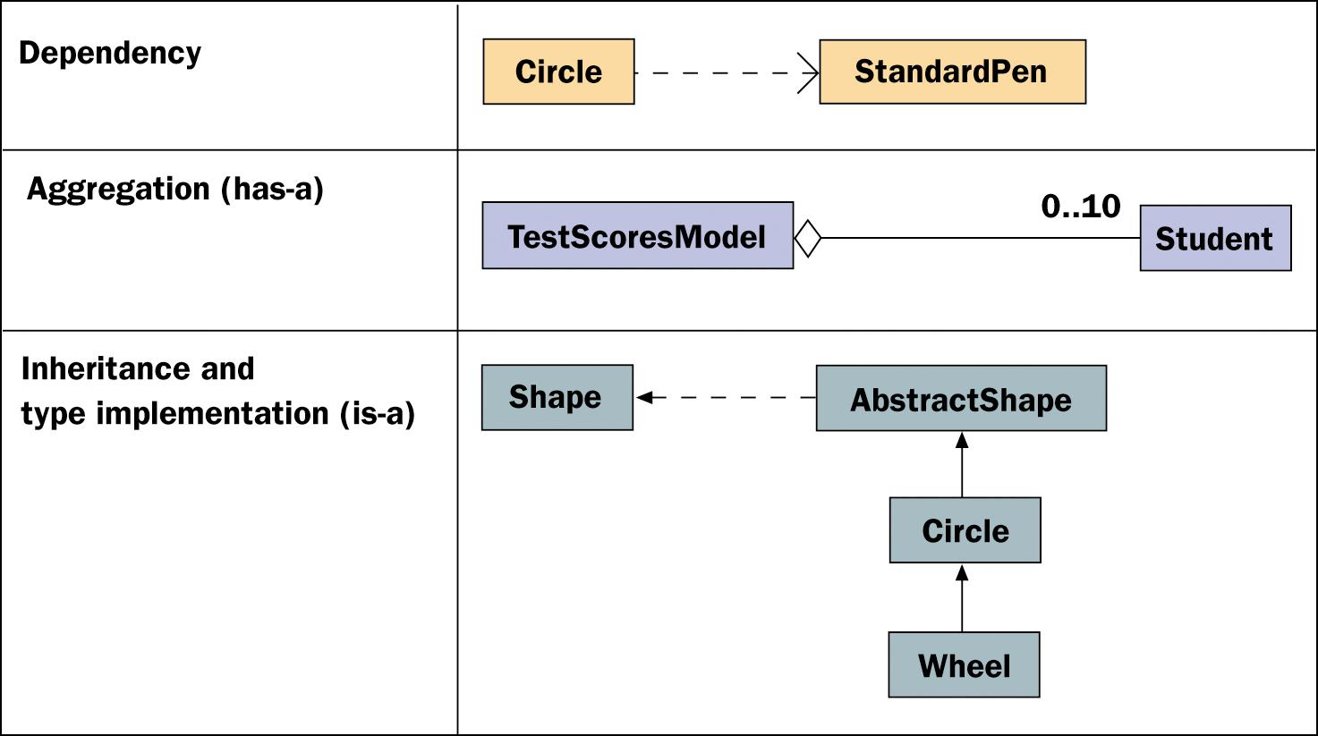
Some Observations About Interfaces, Inheritance, and Relationships Among Classes (continued)
Relationships among Classes (cont):
Three types of relationships among classes

Slide 45
Acceptable Classes for Parameters and Return Values
The rules of Java as enforced by the compiler state that in any situation when an object of class BBB is expected, it is acceptable to substitute an object of a subclass but never of a superclass.
A subclass of BBB inherits BBB’s methods.
No guarantees about the methods in the superclass.
References to objects can be passed to and returned from methods.
‹#›
‹#›

Slide 46
Error Handling with Classes
Preconditions and Postconditions:
Preconditions: things that must be true before a method is invoked.
Postconditions: what will be true after method has executed.
Written as comments above a method’s header.
Not all methods have pre- and postconditions.
‹#›
‹#›

Slide 47
Exceptions
Examples of Exceptions:
Arithmetic, null pointer, out-of-bounds.
Other types of exceptions can be used to enforce preconditions.
Syntax: <a string> is the message to display.
‹#›
‹#›

Slide 48
Exceptions (continued)
How Exceptions Work:
Program keeps track of a chain of method calls.
When code throws an exception, the computer looks for a try-catch statement.
If none, control returns to the caller of the method.
Looks at caller for try-catch, etc.
When the main method is reached, computer halts the program.
Method calls, exception type, and error message.
‹#›
‹#›

Slide 49
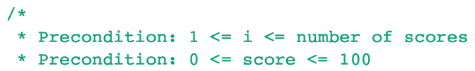
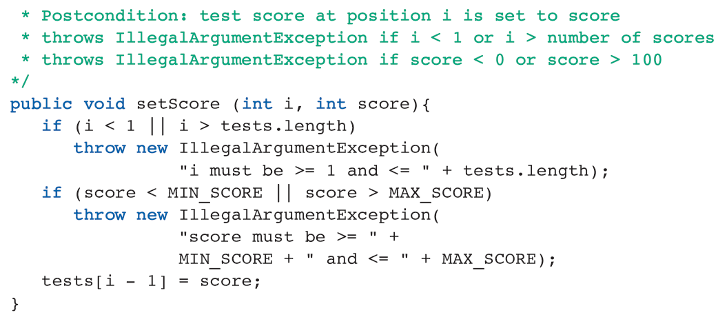
Exceptions (continued)
Throwing Exceptions to Enforce Preconditions:
‹#›
‹#›

Slide 50
Exceptions (continued)
Catching an Exception:
Clients should still check preconditions of methods to avoid run-time errors.
Use an if-else statement to ask questions.
Embed the call to a method within a try-catch.
Attempt the call of a method whose preconditions may be violated.
Catch and respond to exceptions.
‹#›
‹#›

Slide 51
Exceptions (continued)
Creating Online Documentation With javadoc:
Edit the .java file to include special comment syntax to mark the information that will appear in the documentation.
Run the javadoc command with the .java file to create the documentation.
‹#›
‹#›

Slide 52
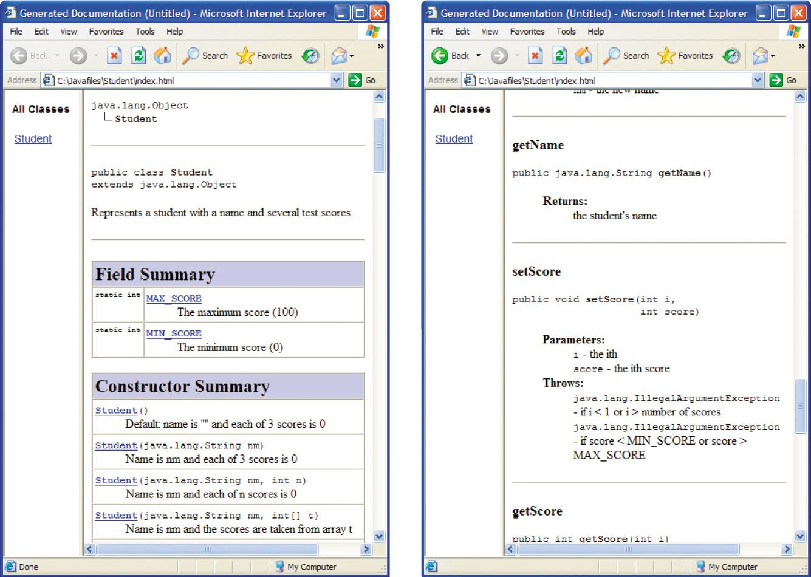
Exceptions (continued)
Creating Online Documentation With javadoc (cont):
javadoc Web pages for the Student class
‹#›
‹#›

Slide 53
Reference Types, Equality, and Object Identity
Aliasing: when more than one variable points to the same object.
Occurs when a programmer assigns one object variable to another.
Comparing Objects for Equality:
Use the equality operator == or the instance method equals.
== tests for object identity; equals tests for structural similarity as defined by implementing class.
‹#›
‹#›

Slide 54
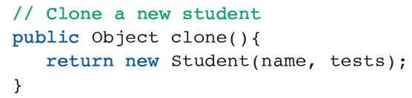
Reference Types, Equality, and Object Identity (continued)
Copying Objects:
The attempt to copy an object with an assignment statement can cause problems.
When clients of a class copy objects, they can implement the Java interface Cloneable.
Authorizes the method clone, which creates a copy.
‹#›
‹#›

Slide 55
Graphics and GUIs: Drawing Multiple Shapes
Java’s Forgetful Bitmap:
The bitmap of a Java graphics content does not retain information about images and shapes after they are drawn to a window.
Programmers write a paintComponent method and use repaint for window refreshes.
‹#›
‹#›

Slide 56
Graphics and GUIs: Drawing Multiple Shapes (continued)
A Database of Circles:
Example: stores circles to be accessed in an array.
paintComponent traverses array to paint all circles.
Method mousePressed in class PanelListener searches the array for a circle that contains the mouse coordinates.
If one is found, the variable selectedCircle is set to that circle.
‹#›
‹#›

Slide 57
Graphics and GUIs: Drawing Multiple Shapes (continued)
A Database of Shapes:
Example: many types of shapes organized in a hierarchy that implements a common interface.
Change array declaration from private Circle[] database; to private Shape[] database;
Now array can store any object whose class implements the Shape interface.
‹#›
‹#›

Slide 58
Graphics and GUIs: Drawing Multiple Shapes (continued)
The Model/View Pattern Revisited:
The panel should be responsible for displaying shapes, not managing array of shapes.
Example: place all of the shapes in a distinct model object of type ShapeModel.
Adding, selecting, and drawing shapes.
‹#›
‹#›

Slide 59
Summary
In this chapter, you learned:
Class (static) variables provide storage for data that all instances of a class can access but do not have to own separately. Class (static) methods are written primarily for class variables.
An interface specifies a set of methods that implementing classes must include. An interface gives clients enough information to use a class.
‹#›
‹#›

Slide 60
Summary (continued)
Polymorphism and inheritance provide a means of reducing the amount of code that must be written by servers and learned by clients in a system with a large number of cooperating classes. Classes that extend other classes inherit their data and methods. Methods in different classes that have the same name are polymorphic. Abstract classes, which are not instantiated, exist for the sole purpose of organizing related subclasses and containing their common data and methods.
‹#›
‹#›

Slide 61
Summary (continued)
Error handling can be distributed among methods and classes by using preconditions, postconditions, and exceptions.
Because of the possibility of aliasing, the programmer should provide an equals method for comparing two objects for equality and a clone method for creating a copy of an object.
‹#›
‹#›

